Slide 1
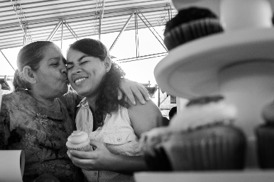
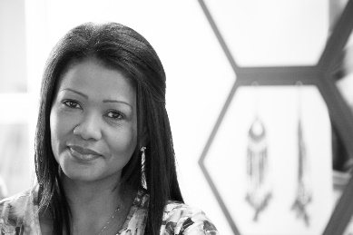


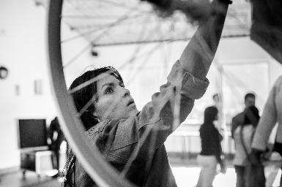
Institutional Presentation
2019

Slide 2
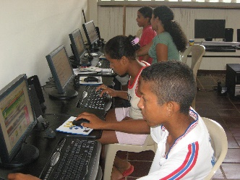
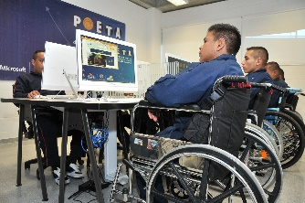
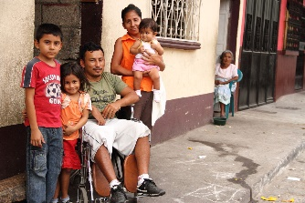
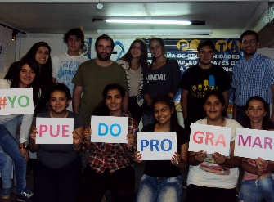
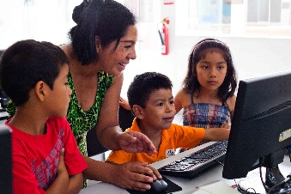
About the Trust for the Americas
The Trust for the Americas is a non-profit organization affiliated with the Organization of American States (OAS). Established in 1997 to promote public and private partnerships, The Trust has implemented projects in 24 countries and worked with over 1,000 organizations in the region. Our initiatives seek to promote educational and economic opportunities as well as government accountability and transparency.
Our unique alliance with the OAS allows us to have access to decision makers within the region. This foundational partnership is the basis through which we create strong networks across member states and the private sector. Through the evolution of our region, The Trust continues to endure by facing challenges through strategic partnerships that promote cooperation for sustainable results.
The Trust of the Americas is a non-profit 501(c)(3) organization.

Slide 3


Slide 4
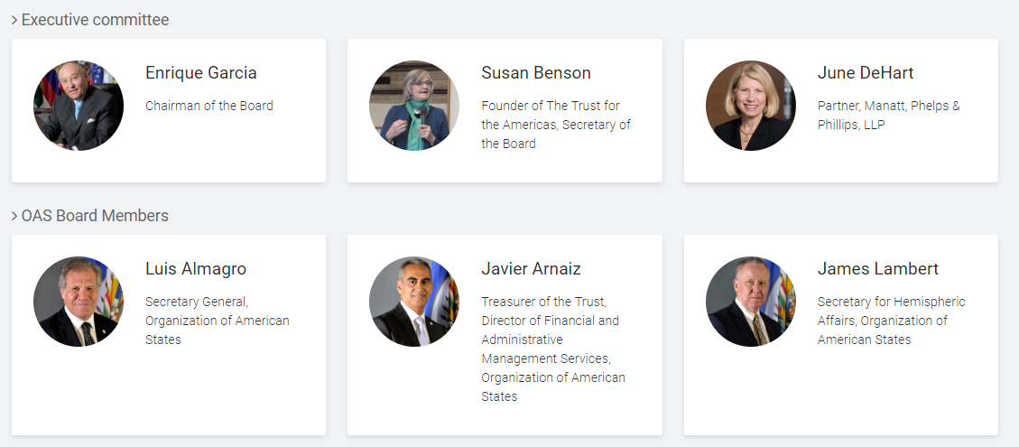
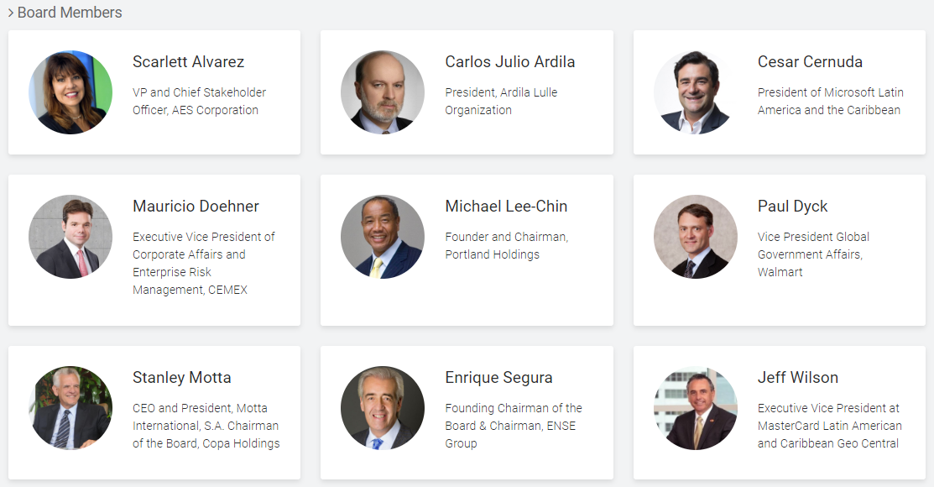
Executive Commitee and OAS Board Members

Slide 5
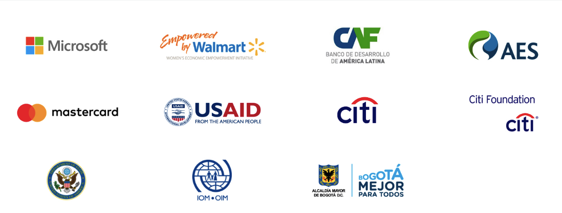

Investments Partners

Slide 6
Contributions and Donations 2014 / 2018

Slide 7
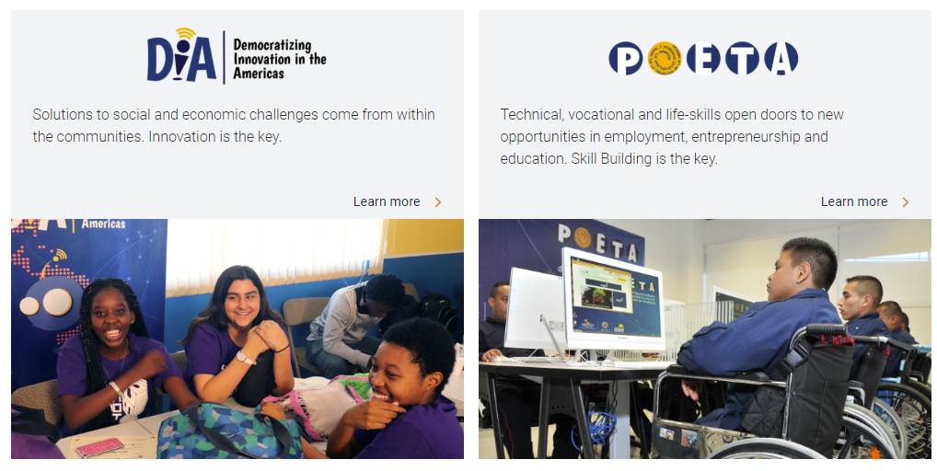
Our Flasgship Programs

Slide 8
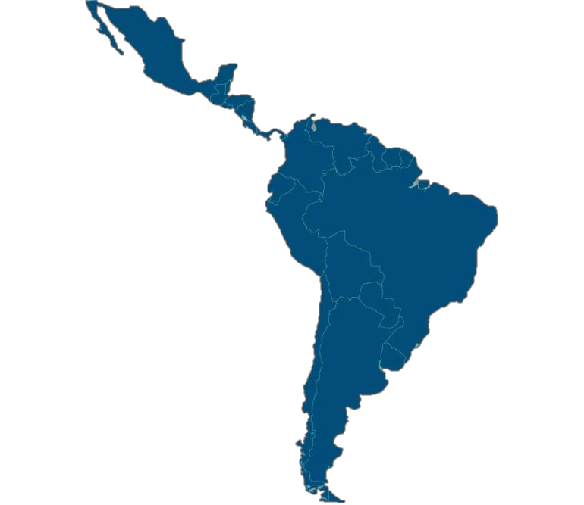









POETA: Economic Opportunities through Technology
Designed to provide necessary skills for the "jobs of the future" and thus provide economic opportunities and social inclusion for vulnerable communities through the use of technologies.
200
Innovation Centres
in
21
Countries
Projects included in POETA:
VIVE-Mexico
POETA YouthSpark-Regional
OIM-Colombia
MasterCard–Colombia
AES-Puerto Rico
A New Path–Jamaica
Programas para migrantes y refugiados
Antigua & Barbuda Argentina
Brazil Chile Colombia Costa Rica
Dominican Republic Ecuador
El Salvador Guatemala Honduras Mexico Panama Peru
St. Kits & Nevis
St. Lucia St. Vincent Venezuela

Slide 9
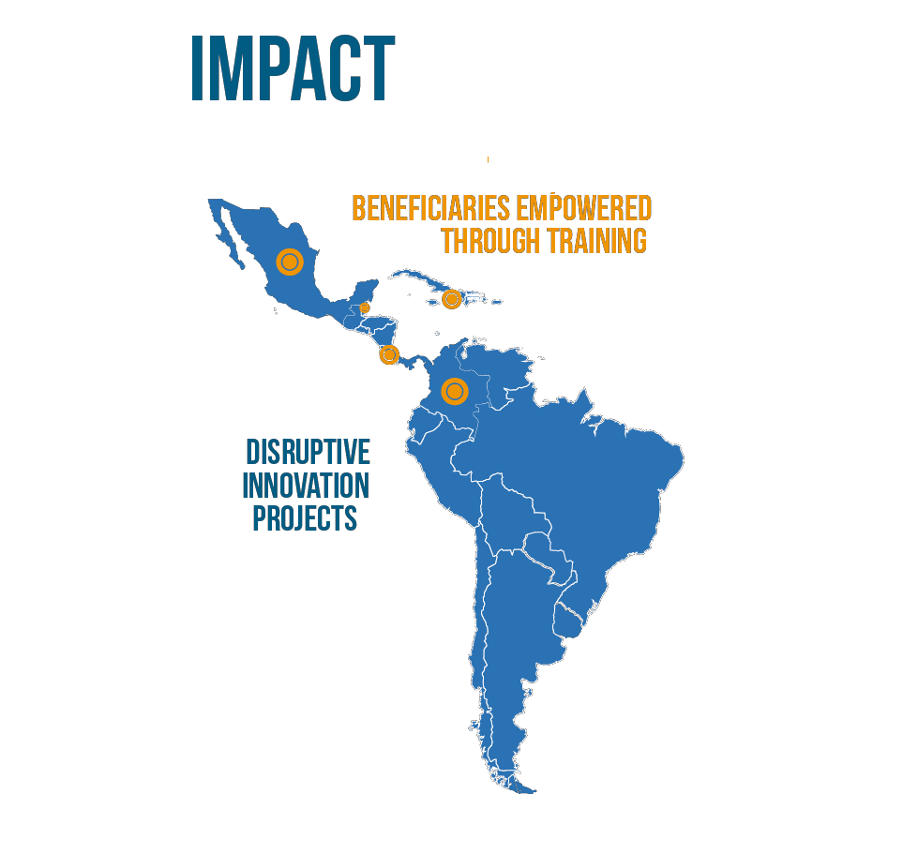
Iniciativa DIA: Democratizing Innovation in the Americas
Designed to promote innovation so that vulnerable populations can create their own ventures and bring them to market.
IMPACT
3.172
Beneficiaries through training
Innovation Labs
Open Government Programs
Private / Public Partnerships
497
Disruptive
Projects
Implemented
Belize I Colombia I Costa Rica I Jamaica I Mexico

Slide 10
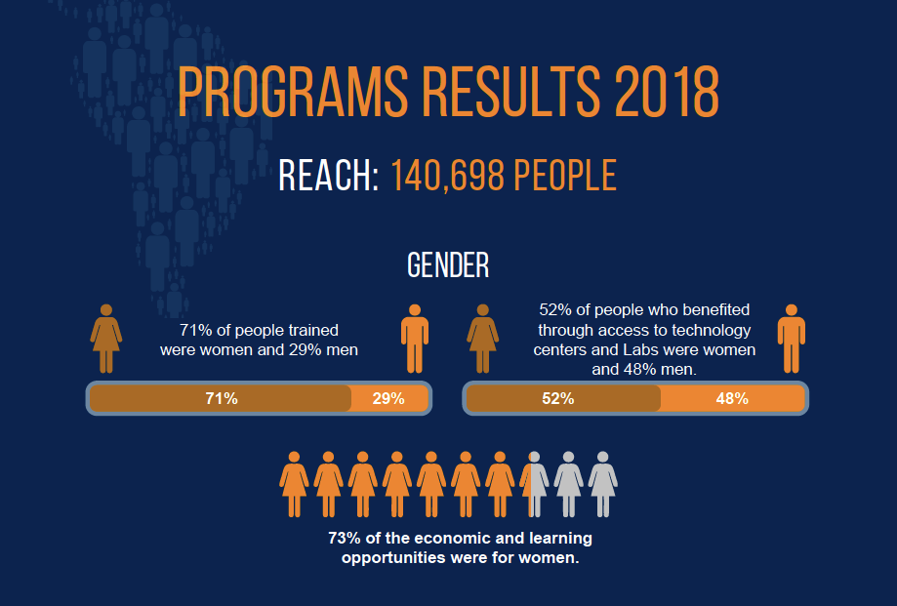
Beneficaires 2018

Slide 11
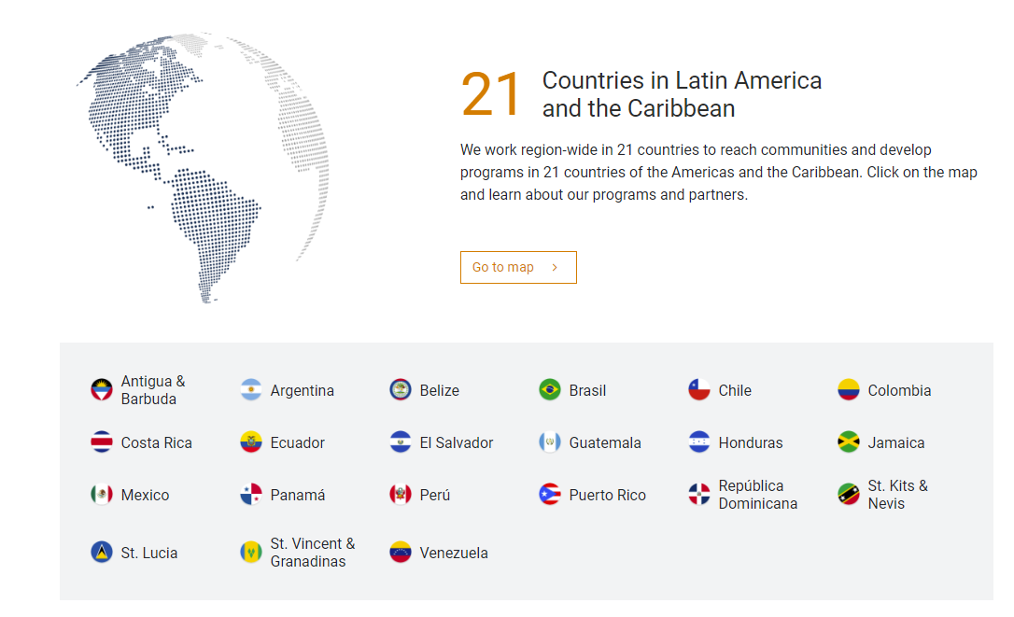
Presence

Slide 12
Lara Bersano Calot
Director of Communications
The Trust for the Americas – Organization of American States
lbersano@trust-oea.org
M. +1 202 460 9573
P: +1 202 3700761
1889 Constitution Ave NW, Washington DC, 20006.-

