Slide 1



Bridging gaps
in the Americas
2023

Slide 2

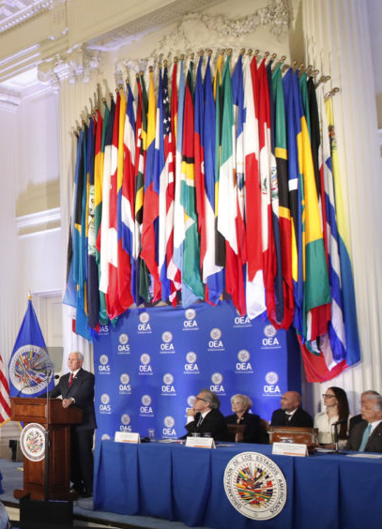
About
The Trust for the Americas
501(c)(3) not for profit organization
Affiliated with the Organization of American States
Legal presence in Canada & Colombia
Based in Washington DC

Slide 3
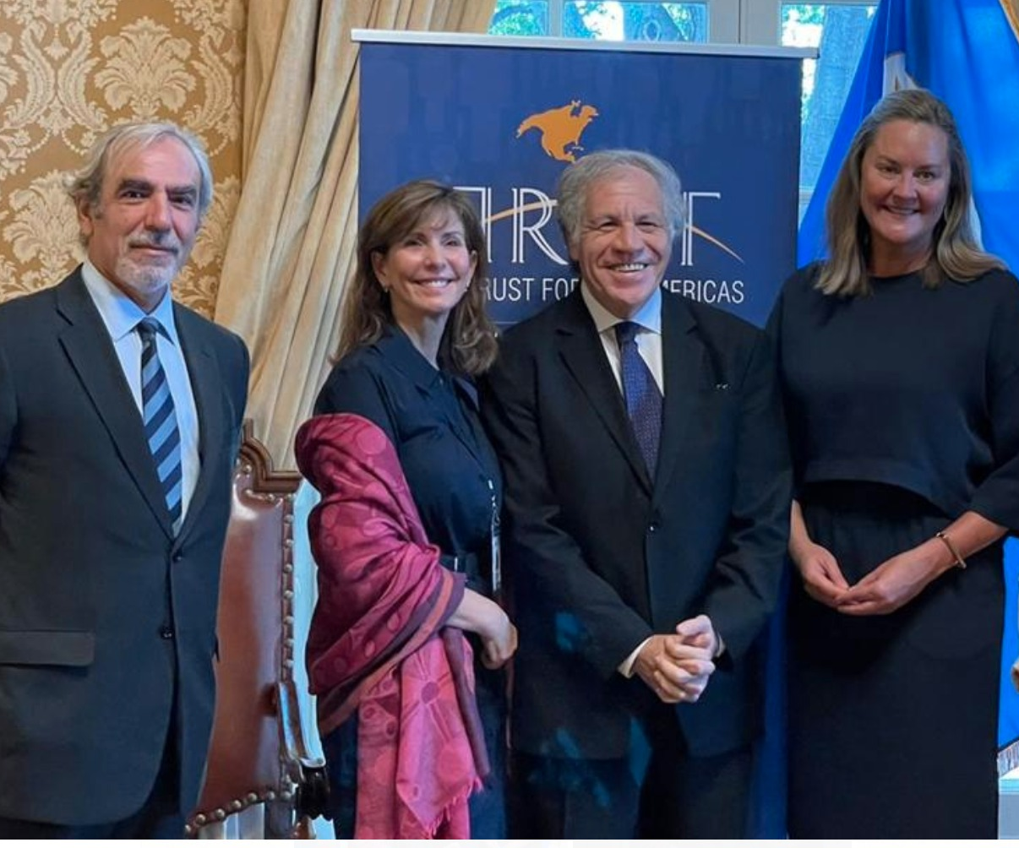
Working with the OAS
Implement projects mandated by the SG and Member States
Connect the private with the public sector.
Vehicle within the OAS.
Notes:
Joint projects and affiliated
New Path

Slide 4

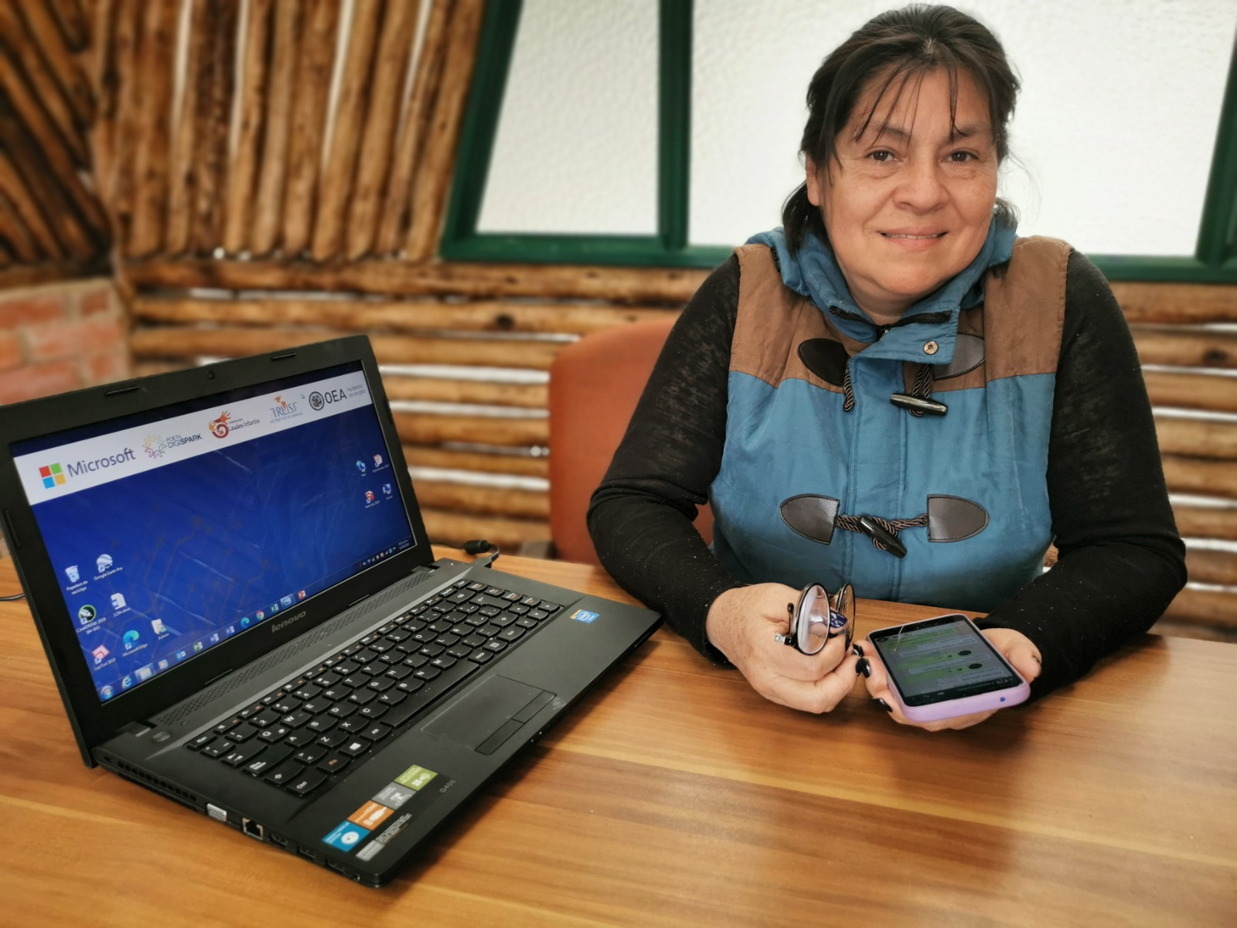
What we do
Promote social and economic inclusion for vulnerable communities in the Americas through partnerships with the public, private and non-profit sectors.
Areas of focus:
  Future of work
  Innovation

Slide 5
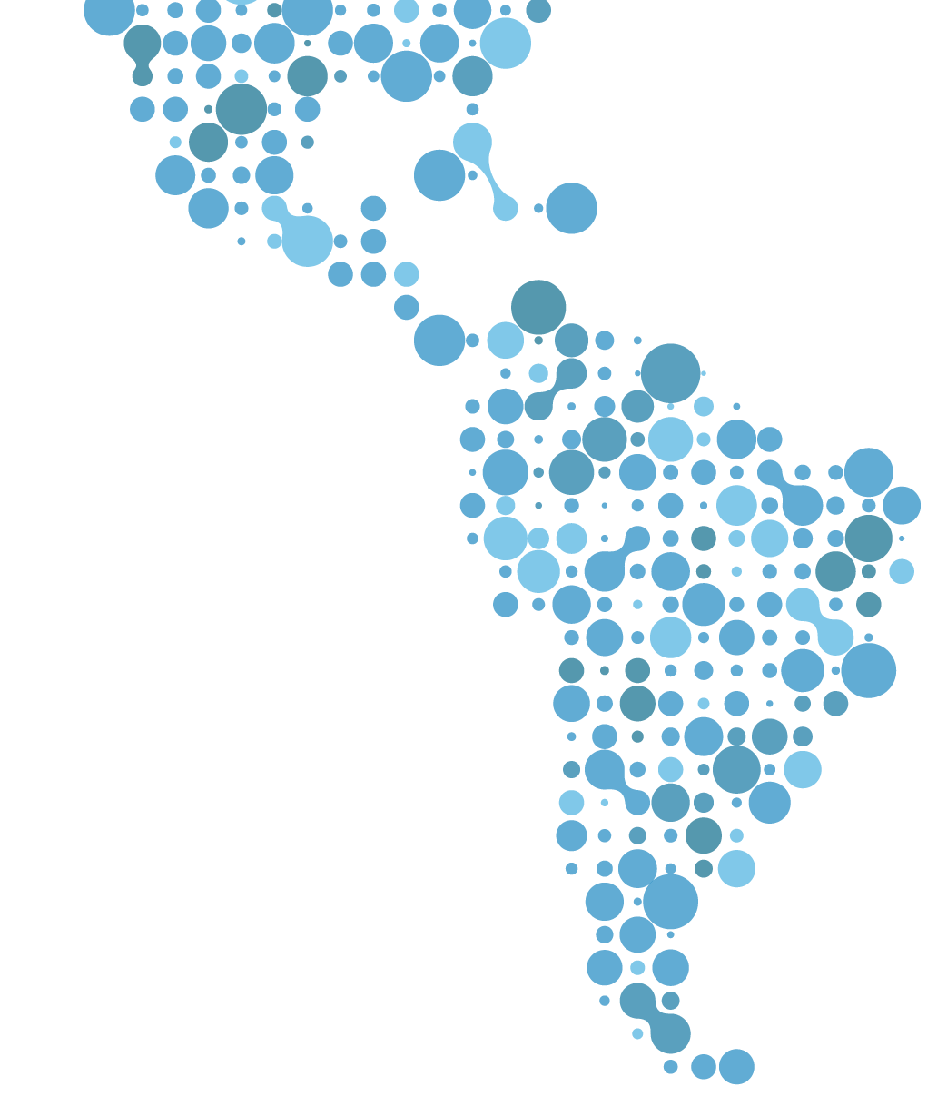



























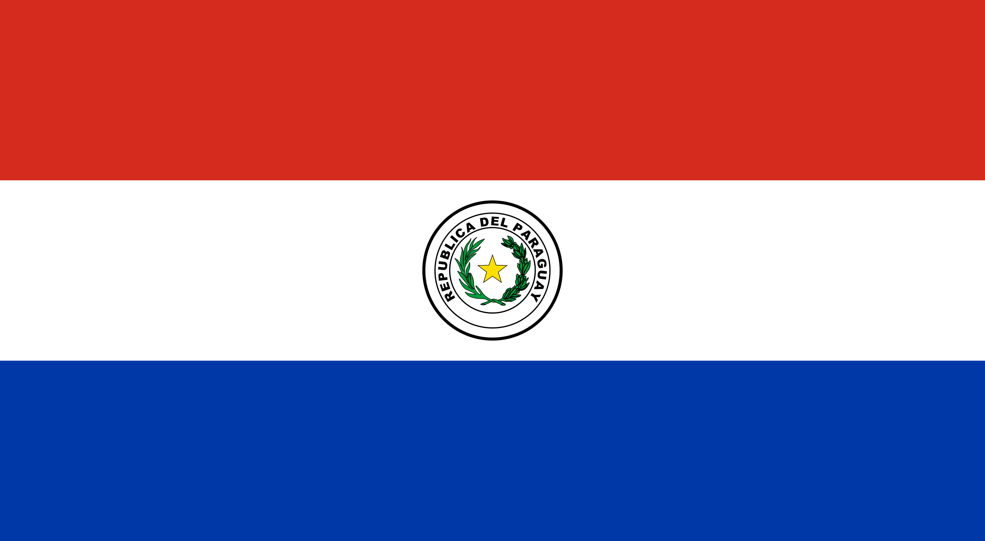

OUR FOOTPRINT
29
ANTIGUA & BARBUDA
ARGENTINA
BARBADOS
BELICE
BRASIL
BOLIVIA
CANADA
CHILE
COLOMBIA
COSTA RICA
DOMINICA
REPÚBLICA DOMINICANA
ECUADOR
EL SALVADOR
GRANADA
GUATEMALA
HAITÍ
HONDURAS
JAMAICA
MÉXICO
PANAMÁ
PERÚ
PUERTO RICO (USA)
PARAGUAY
SANTA LUCIA
SAN CRISTÓBAL Y NIEVES
TRINIDAD Y TOBAGO
URUGUAY
VENEZUELA
Countries historically
1,000
Organizations
4.5M
Impacted People
384
POETA Centers
DIA Labs

Slide 6



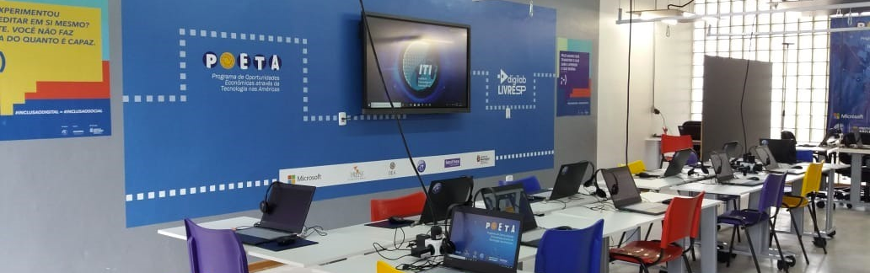
How we do it:
Technology as a cross cutting tool
Technology for the skills needed for economic independence.
In-Person Technology Training Centers.
Aula Virtual: over 70 courses online

Slide 7











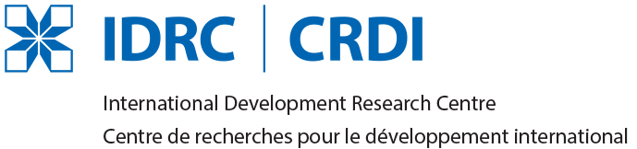





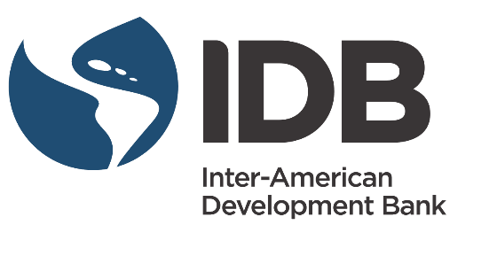
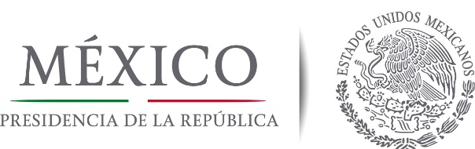



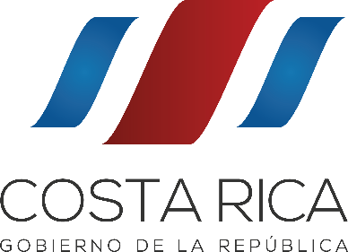








Leveraging our Partnerships
PUBLIC SECTOR
PRIVATE SECTOR
Notes:
Key partnerships – work with OAS missions – 70% funding comes from private sector

Slide 8
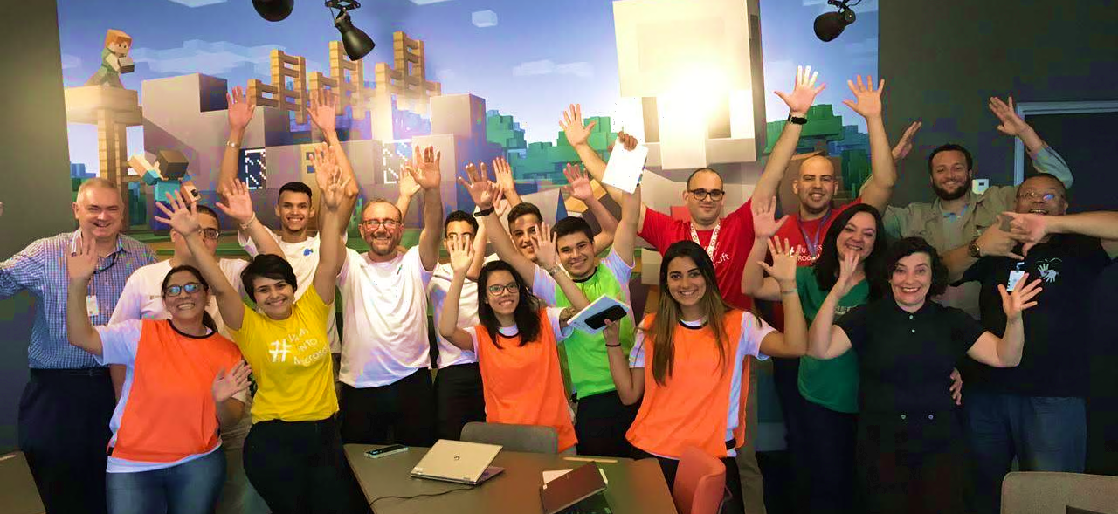
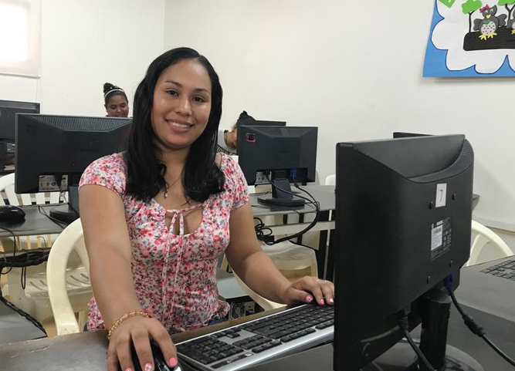
Partnering with local CSOs
Five Core Strategies: Comprehensive training, communications, economic opportunities, M&E, sustainability.
How we do it:
Strengthening Local Partners
Notes:
1,000 over the years – currently parterned with 51 CSOs

Slide 9



Provide skills
Help people get jobs and expand micro-enterprises.
Promote innovation in small businesses & governments.
Programs

Slide 10

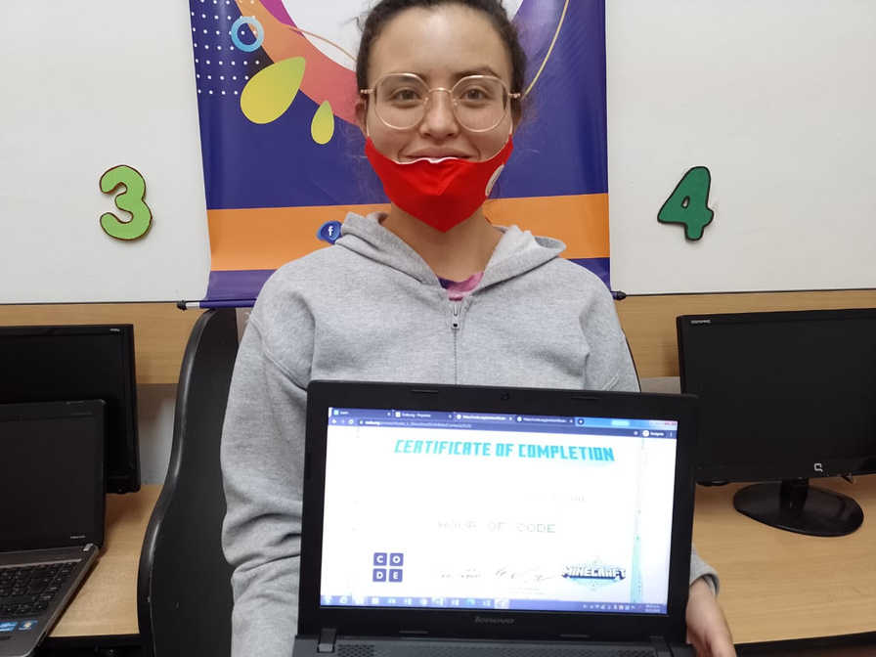
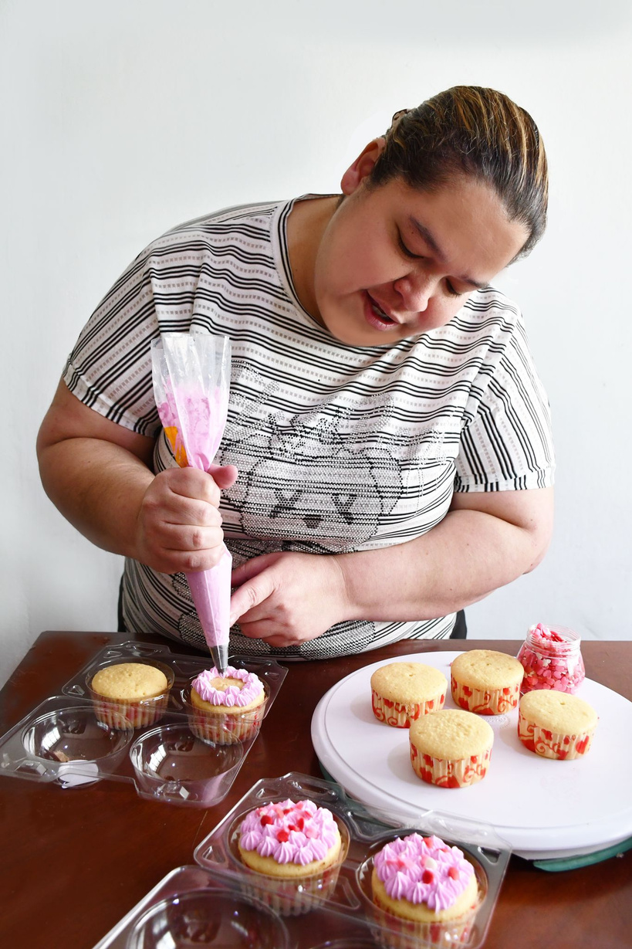
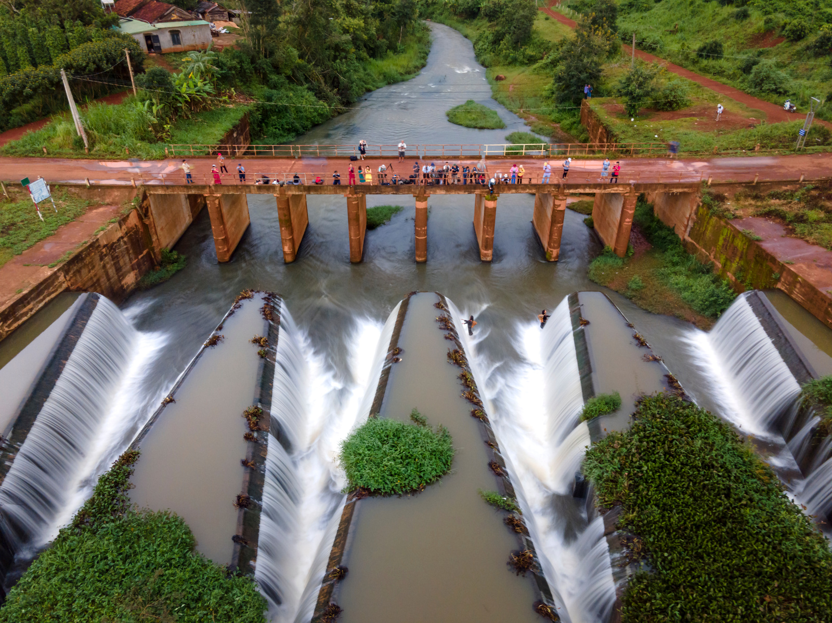
Cross Cutting Themes
Gender
Entrepreneurship
Adaptation to risk/climate change

Slide 11





The Trust for the Americas
Follow us on Social Media
The Trust for the Americas
Trust4Americas
Trust4Americas

