Slide 1



Bridging gaps
in the Americas
July 2022

Slide 2

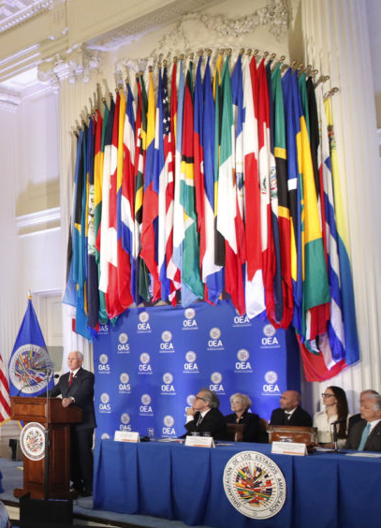
About
The Trust for the Americas
501(c)(3) not for profit organization
Affiliated with the Organization of American States
Legal presence in Canada & Colombia
Based in Washington DC

Slide 3
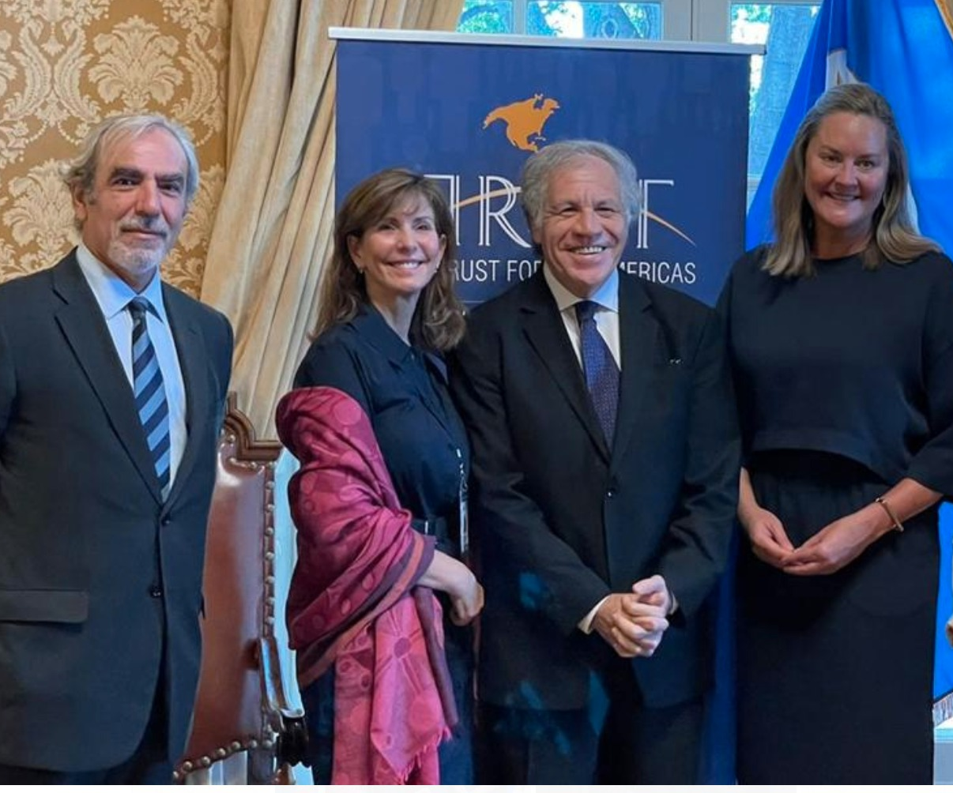
Working with the OAS
Implement projects mandated by the SG and Member States
Connect the private with the public sector.
Vehicle within the OAS.
Notes:
Joint projects and affiliated
New Path

Slide 4

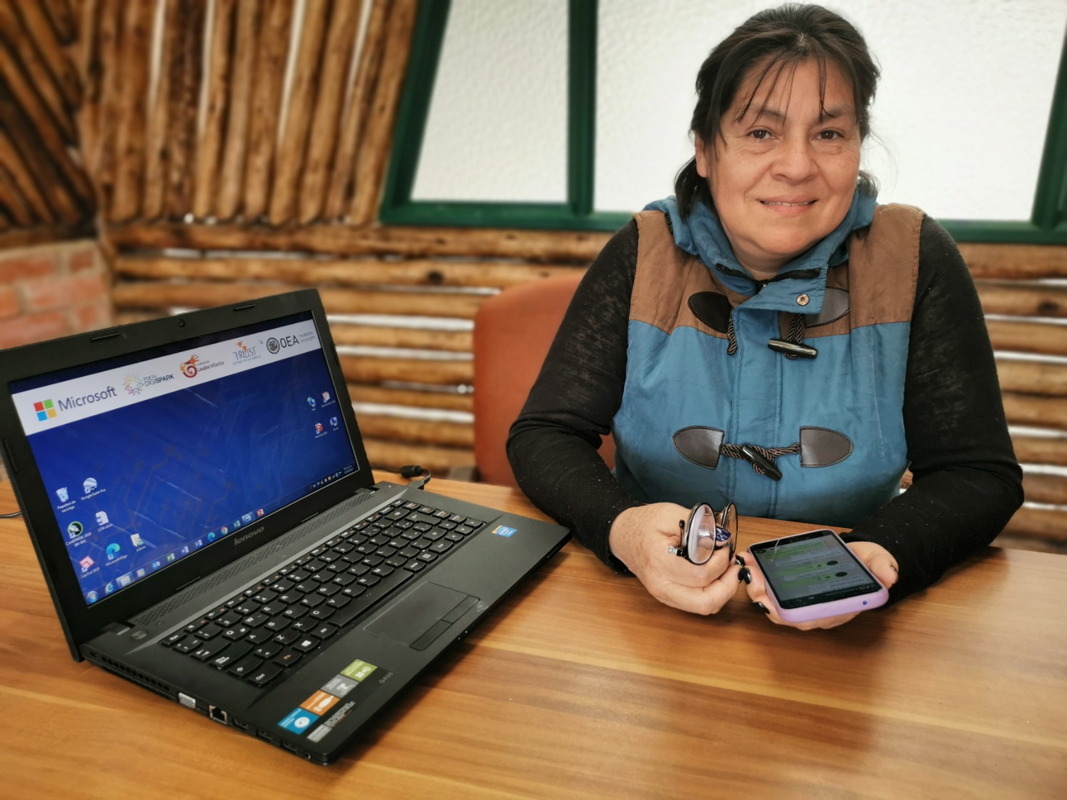
What we do
Promote social and economic inclusion for vulnerable communities in the Americas through partnerships with the public, private and non-profit sectors.
Areas of focus:
  Future of work
  Innovation

Slide 5
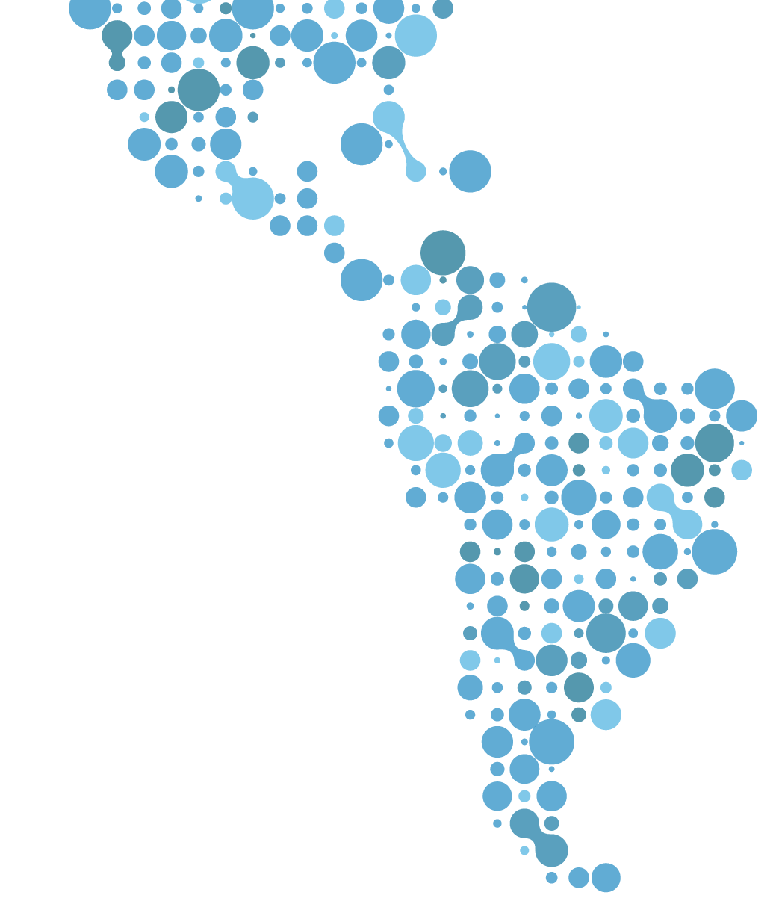


























OUR FOOTPRINT
ANTIGUA Y BARBUDA
ARGENTINA
BELIZE
BRAZIL
BOLIVIA
CHILE
COLOMBIA
COSTA RICA
DOMINICA
DOMINICAN REPUBLIC
ECUADOR
EL SALVADOR
GRANADA
GUATEMALA
HAITI
HONDURAS
JAMAICA
MEXICO
PANAMA
PERU
PUERTO RICO (UNITED STATES)
SAINT LUCIA
ST. KITTS & NEVIS
TRINIDAD & TOBAGO
URUGUAY
VENEZUELA
26
Countries historically
1,000
Organizations
3.5M
People impacted

Slide 6



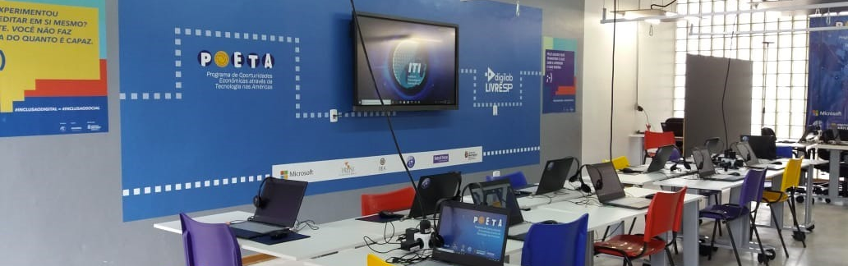
How we do it:
Technology as a cross cutting tool
Technology for the skills needed for economic independence.
In-Person Technology Training Centers.
Aula Virtual: over 70 courses online

Slide 7































Leveraging our Partnerships
PUBLIC SECTOR
PRIVATE SECTOR
Notes:
Key partnerships – work with OAS missions – 70% funding comes from private sector

Slide 8
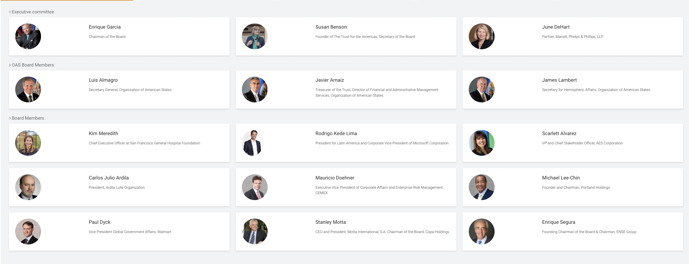
Board of Directors
Notes:
Microsoft, Cemex, COPA, AES, Walmart with geographical and industry representation

Slide 9
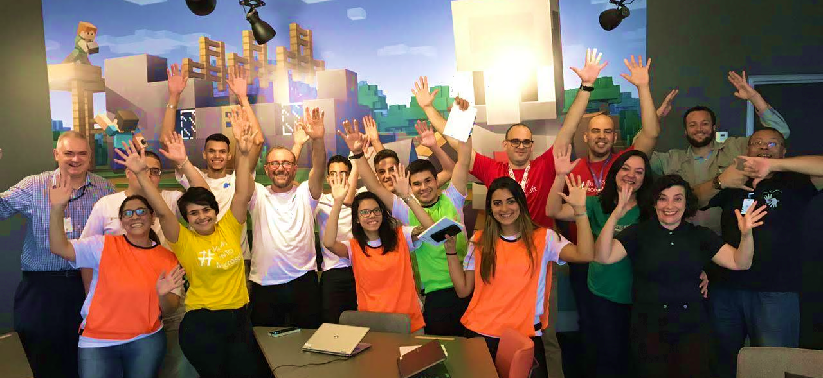
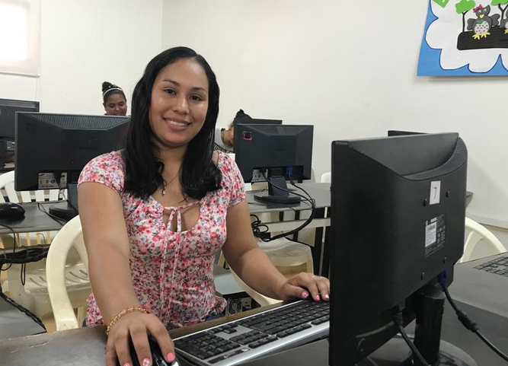
Partnering with local CSOs
Five Core Strategies: Comprehensive training, communications, economic opportunities, M&E, sustainability.
How we do it:
Strengthening Local Partners
Notes:
1,000 over the years – currently parterned with 51 CSOs

Slide 10


Our Team
The Trust is only as good as the people that work here.
45 people in 11 countries.
Multidisciplinary professionals.
Notes:
Liase with leadership with our 352 centers and labs in the hemisphere

Slide 11


Slide 12



Provide skills
Help people get jobs and expand micro-enterprises.
Promote innovation in small businesses & governments.
Programs

Slide 13
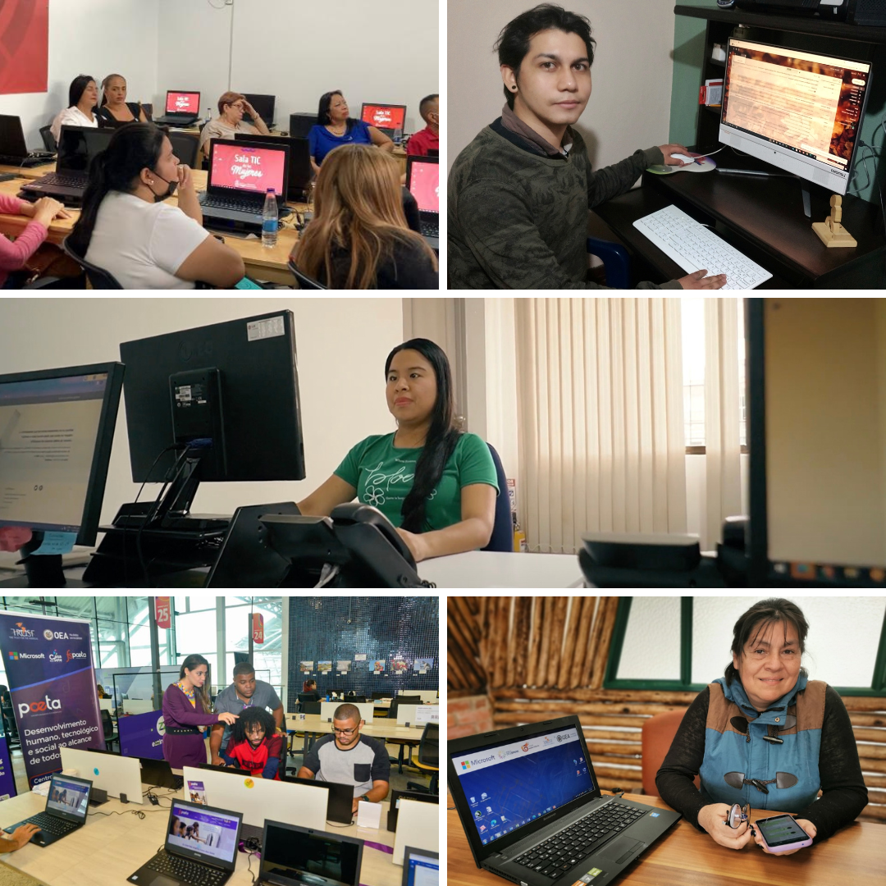

Future of work: POETA
Productivity through digital inclusion.
Digital & computer science skills.
Technical and life skills.
Economic opportunities: entrepreneurial ventures, job placement and seed funding.
Notes:
Tell story of how POETA started

Slide 14
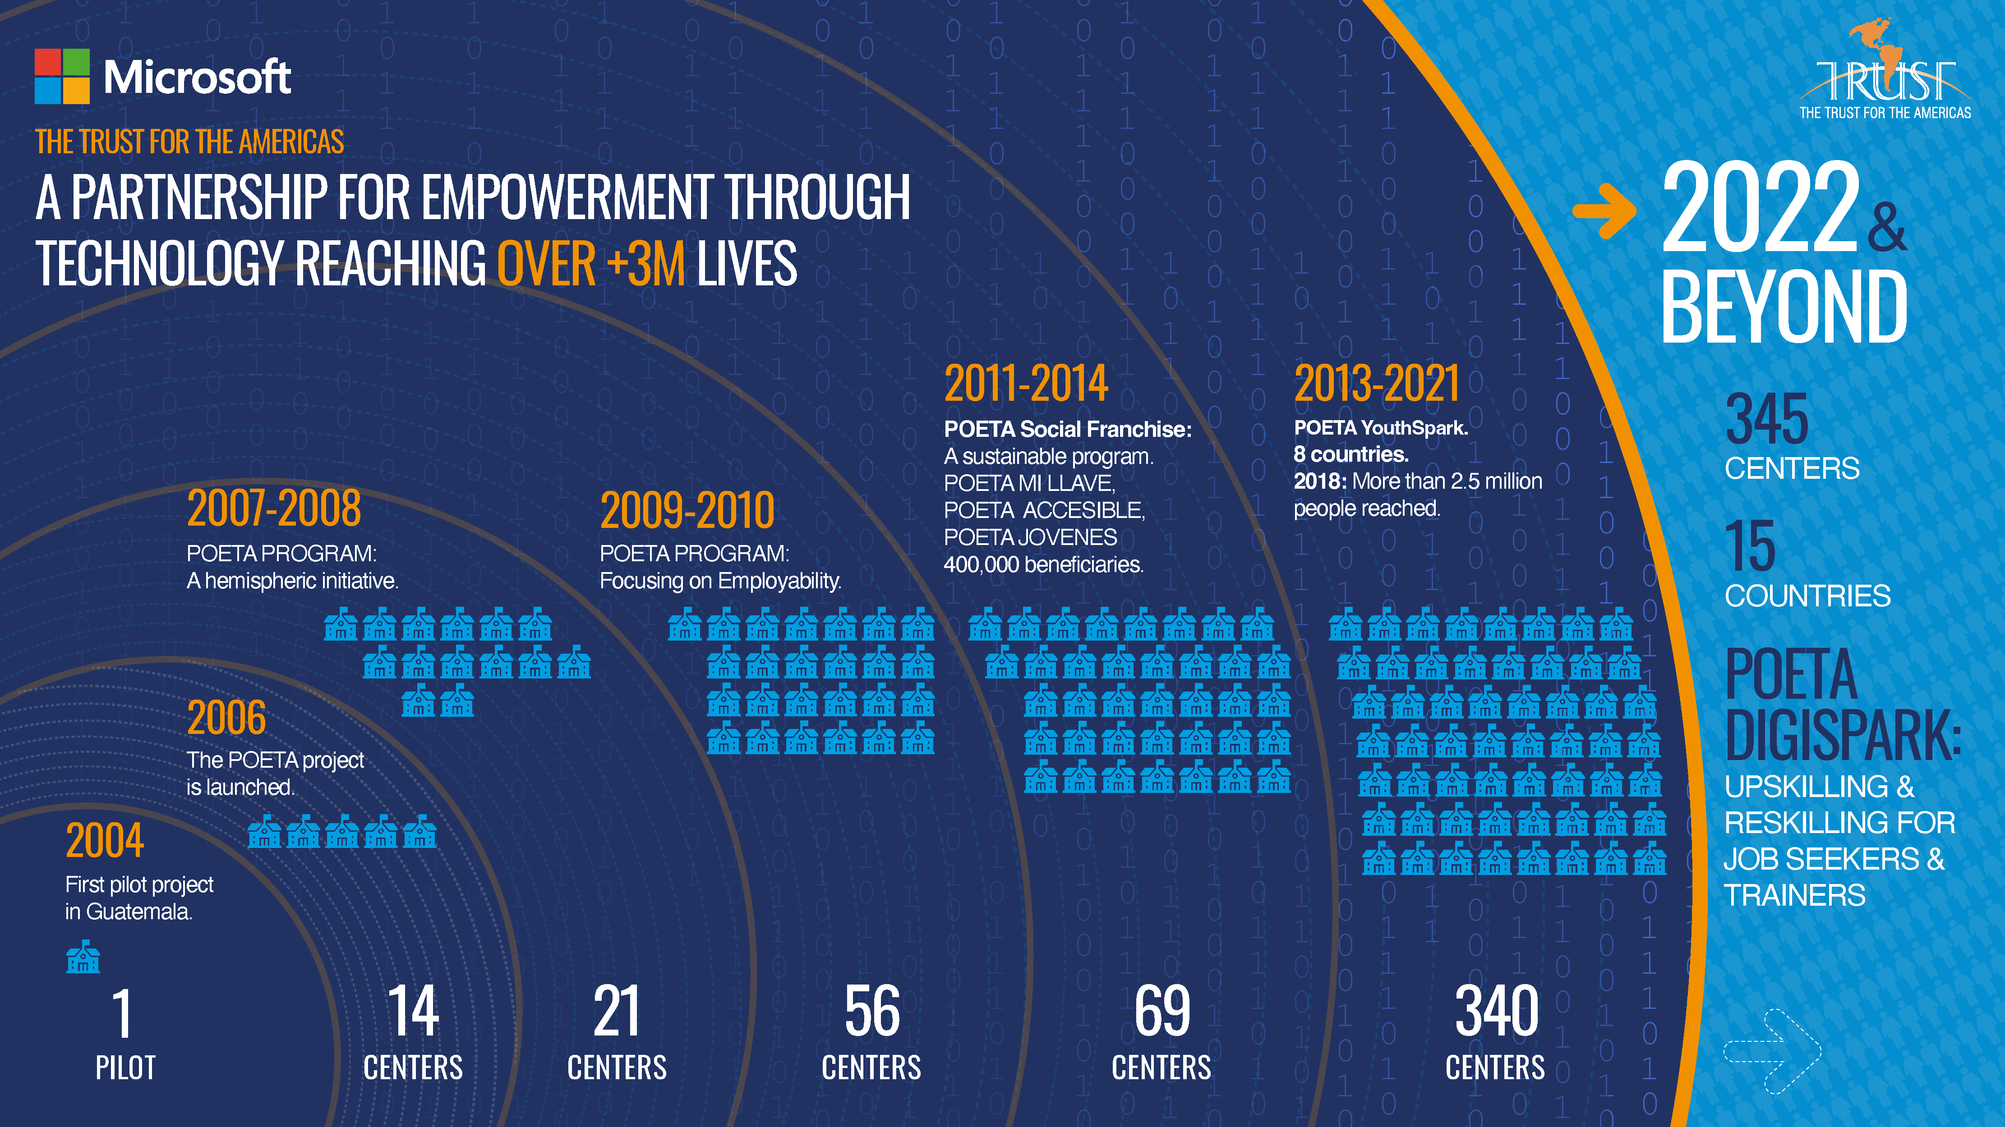

Slide 15

Innovation: DIA
Regional initiative that fosters innovation and empower new generations.
Teaching people to create technology to:
  Catalyze small business development.
  Registration and formalization of enterprises.
  Seed funding.
DIA Labs curriculum:
  Pitch tank competitions
  Ideathons
Notes:
Tell story how we started DIA in 2016

Slide 16

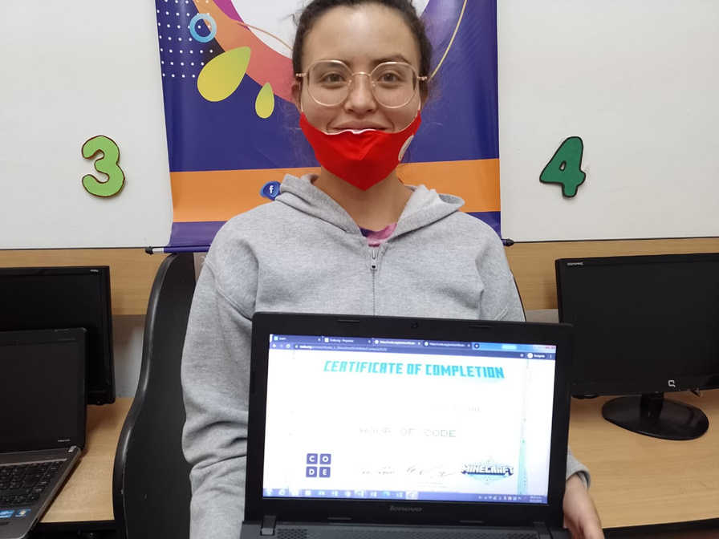
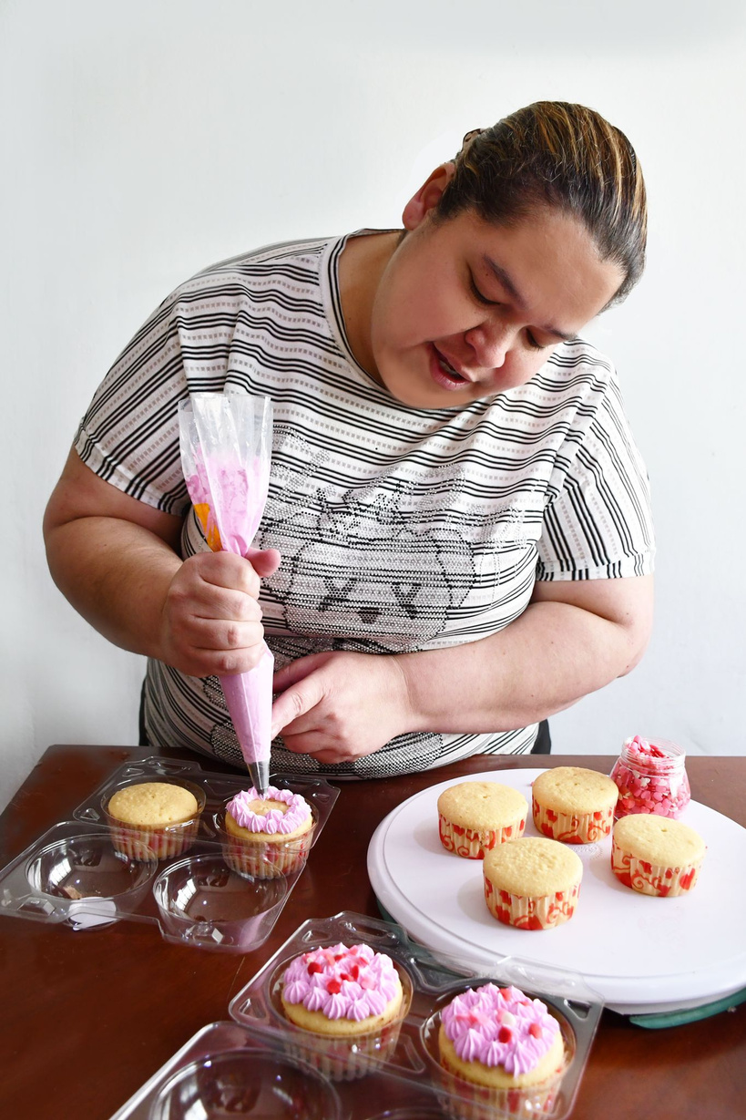

Cross Cutting Themes
Gender
Entrepreneurship
Adaptation to risk/climate change

Slide 17




The Trust for the Americas
Follow us on Social Media
The Trust for the Americas
Trust4Americas
Trust4Americas

